Slide 1
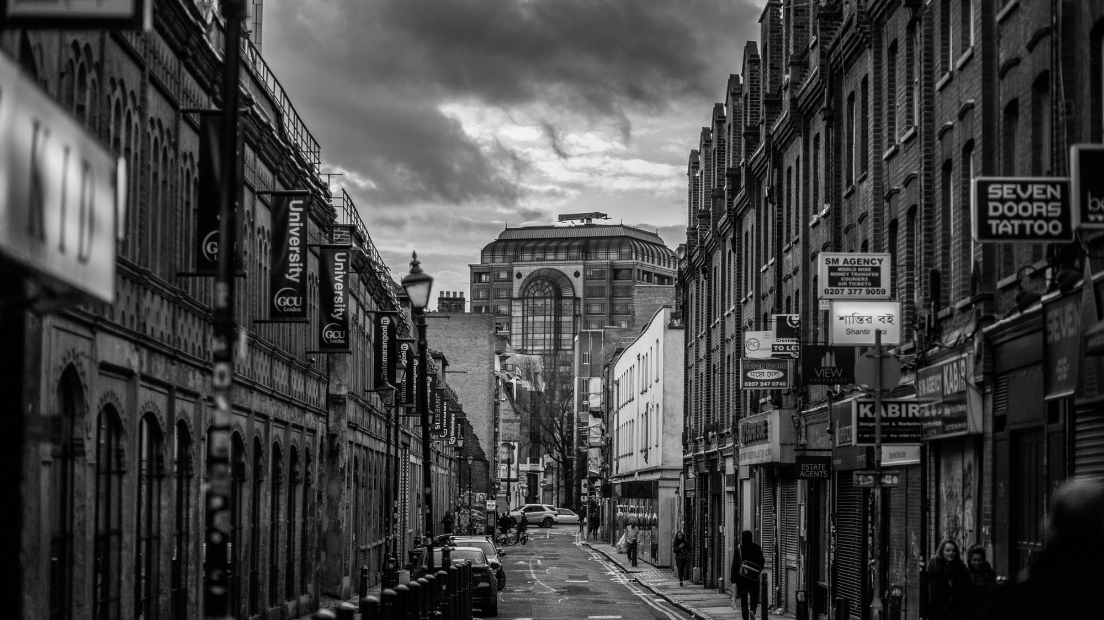
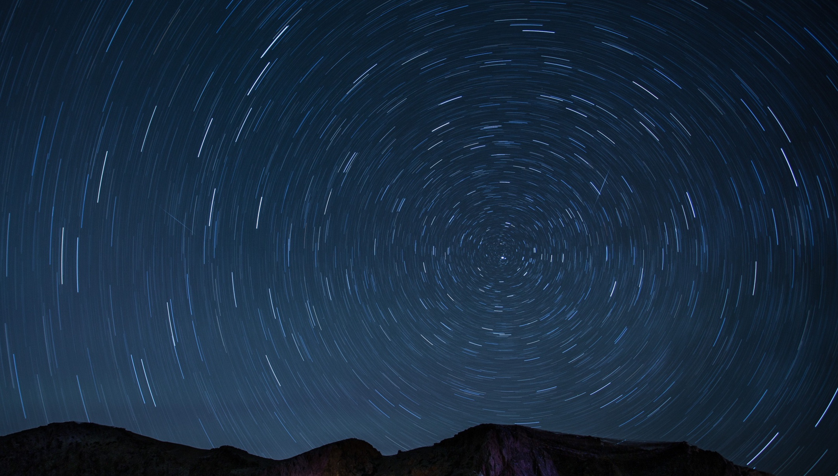
Project Proposal
Pix 2 Pix
Team Member
Youngjun Ju(주영준)
Kiwon Seo(서기원)

Slide 2
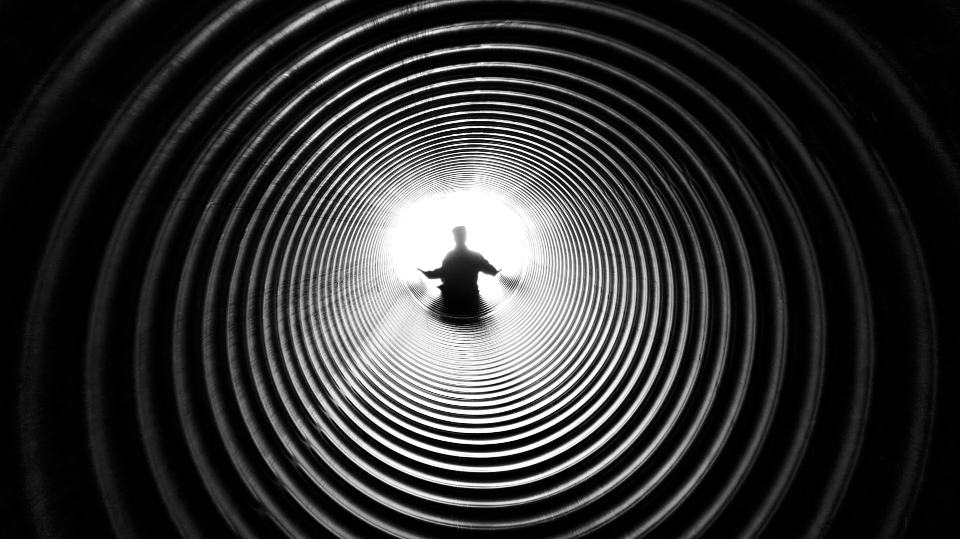

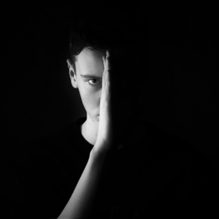

INDEX
GOAL
DESCRIPTION
SCHEDULING

Slide 3

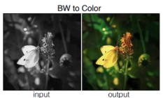
Goal
Pix2Pix
Grayscale images -> Color Images
Goal :
Using Pix2Pix to transform Grayscale images into Color Images
Applications :
We can change many gray-scale images from history books into color images
We can change ancestor's gray-scale images into color images

Slide 4

Description
GAN
Pix2Pix
Pix2Pix is one of field of GAN
It can be used in various fields :
Gray-scale images to color images
Day to Night
Edges to Photo
Labels to Street Scene
Etc.

Slide 5
Scheduling
Studying
Debugging
Presentation
Planning
Implementing
Applications

Slide 6

Project Proposal
Team Project
THANK YOU

